Slide 1
the Right Content to the Right Audience at the Right Time
How to Deliver

Slide 2
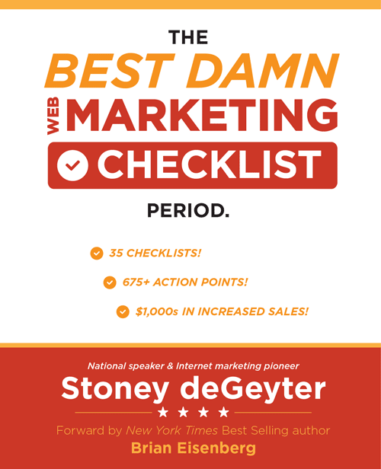
This is me
I do this
Web Presence Optimization
Follow me here
@StoneyD
linkedin.com/in/stoneygd
Stoney deGeyter
Read my book
2.0
WebMarketingChecklist.com
Hire my team
PolePositionMarketing.com

Slide 3
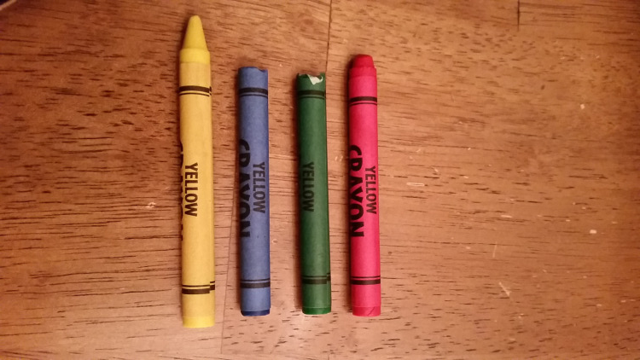
Marketers have one job
Gain new customers
Generate more sales
Become an authority

Slide 4
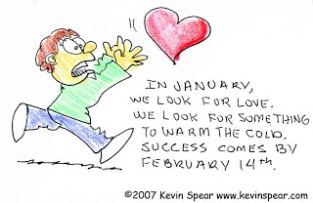
Customers are like love
They are usually found when you’re not looking!

Slide 5
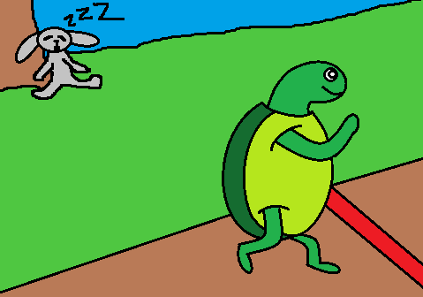
SALES
AUTHORITY

Slide 6
Two ways to build authority
MASS KEYWORD CONTENT
AUTHORITY TOPICAL CONTENT
VS.

Slide 7
Keyword Research is Not Dead

Slide 8
Keywords aren’t just for search engines
Effective authority building uses keywords to understand your audience.

Slide 9
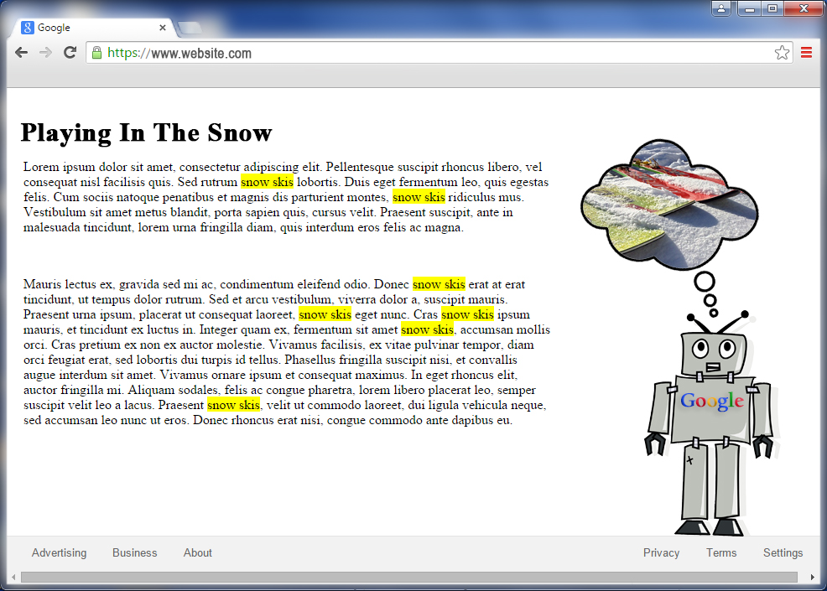
Keyword data is still valuable
Cordless telephone headset

Slide 10
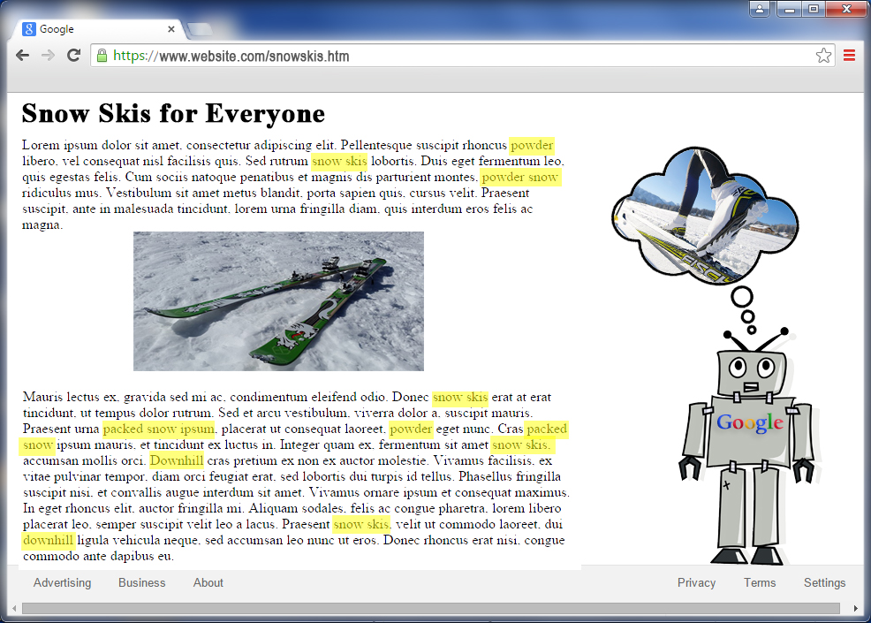
There’s more to a keyword than the keyword
Cordless telephone headset

Slide 11
Forget about search engines…
…and focus on search intent.

Slide 12
True optimization is intent optimization
Search engines and SEOs have the same goal
Provide the best solution.

Slide 13
Understanding Searcher Intent

Slide 14
Different searchers have different intents
Researchers
Shoppers
Buyers
Shop
Comparing Aspects
Buy
Looking at Specifics
Research
Deciding on Needs
Info
Seeking Knowledge

Slide 15
It’s not always obvious – keywords lie
“cordless telephone” headset
cordless “telephone headset”
cordless telephone headset
Cordless telephone headset

Slide 16
What is the intent for: acrylic nails?
Can you create a single “authoritative” page covering all these?
Designs
Glitter
Supplies
Tips
Kits
Powder
Polish
Brushes
Art

Slide 17
Create topical groups
DESIGNS
SUPPLIES
TIPS
for summer
black
simple
black and white
pink
for spring
ideas
cute
matte
wholesale
online
near me
cheap
professional
kit
for sale
store
quality
for sale
wholesale
only
with gel overlay
with designs
kit
french
colored
professional

Slide 18
Topical Optimization Versus Keyword Optimization

Slide 19
Keyword optimization: one keyword / page
acrylic nail designs for summer
acrylic nail design ideas
black acrylic nail designs
acrylic nail designs
simple acrylic nail designs
pink acrylic nail designs
acrylic nail designs matte
spring acrylic nail designs

Slide 20
Topical optimization: one intent / topic
Shop
Buy
Research
Info
best
full
cute
for summer
for spring
long
short
black
matte
art
designs
2018
gallery
ideas
pictures

Slide 21
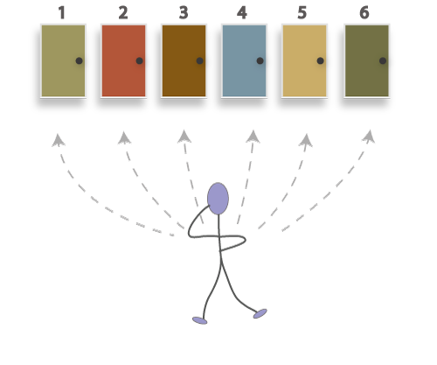
Multiple authoritative topics of entry

Slide 22
4 Basic Search Intents That Require Content

Slide 23
1. Navigational intent
Branded content
A query that takes you to a specific site.

Slide 24
2. Informational intent
A broad for general information.
Write content that answer questions
Create how-to content & videos
Step-by-step instructions
Infographics

Slide 25
3. Investigational intent
Click-worthy title tags
Problem / solution oriented
Robust product category information
A query to learn more about available options.

Slide 26
4. Transactional intent
Product-specific title tags
Robust product description
Model numbers & pricing
A query that leads to a transaction.

Slide 27
Every intent requires a unique page
HOME
Navigational
Investigational
CATEGORY 1
CATEGORY 2
CATEGORY 3
BLOG
Informational
Transactional
SUB- CATEGORY
1
SUB- CATEGORY
2
SUB- CATEGORY
3
SUB- CATEGORY
1
SUB- CATEGORY
2
SUB- CATEGORY
3
Product 1
Product 2
Product 3
Product 1
Product 2
Product 3
Product 1
Product 2
Product 3
Product 1
Product 2
Product 3
Product 1
Product 2
Product 3
Product 1
Product 2
Product 3

Slide 28
4 Steps to Match Intent with Landing Pages

Slide 29
Determine the intent of every URL
1
Focus on
New pages
Existing URLs
Before creating

Slide 30
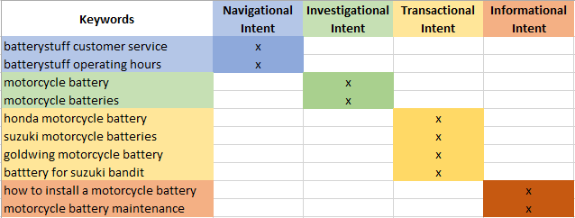
Determine the intent of every keyword
2
research
shop
buy
Think about what the searcher expects to find when they conduct each search.

Slide 31
Organize similar-intent keywords by topic & URL
3
Batterystuff shipping policies
Batterystuff honda motorcycle battery
Battery charger batterystuff
How to charge a battery battterystuff.com
Research
motorcycle battery
motorcycle batteries
battery motorcycle
battery motorcycles
batteries motorcycle
battery for motorcycle
motorcycles battery
HOME
Navigational
Informational
how much is a motorcycle battery cost
which motorcycle battery
how much is a new motorcycle battery
how much does a motorcycle battery cost
where to buy a motorcycle battery
where can i buy motorcycle batteries
CATEGORY 1
CATEGORY 2
CATEGORY 3
BLOG
Shop
SUB- CATEGORY
1
SUB- CATEGORY
2
SUB- CATEGORY
3
SUB- CATEGORY
1
SUB- CATEGORY
2
SUB- CATEGORY
3
harley davidson motorcycle battery
harley davidson motorcycle batteries
harley motorcycle battery
motorcycle batteries harley davidson
harley motorcycle batteries
Product 1
Product 2
Product 3
Product 1
Product 2
Product 3
Product 1
Product 2
Product 3
Product 1
Product 2
Product 3
Product 1
Product 2
Product 3
Product 1
Product 2
Product 3
dual pro
dual pro battery chargers
dual pro charger
dual pro battery charger
dual pro chargers
Buy

Slide 32
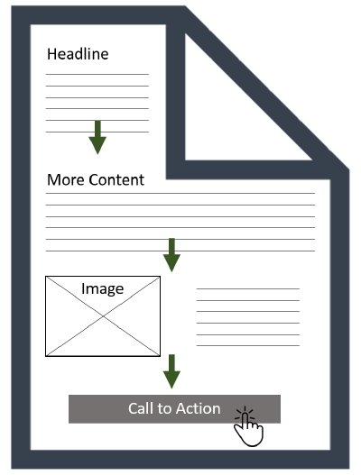
Write intent-driven content
4
Determine the mission of each page.
Write content that supports the mission--top to bottom

Slide 33
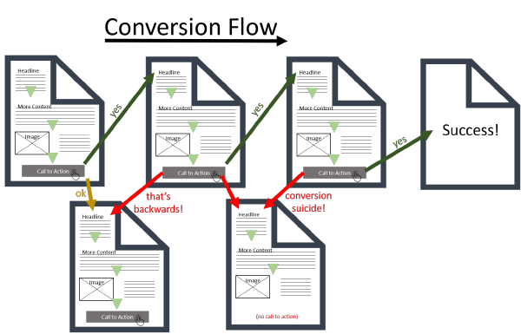
Provide an action that fulfills the intent
5
Answer the question, “What’s next?”
and provide the action to do it.

Slide 34
The Endgame: Be Unique

Slide 35
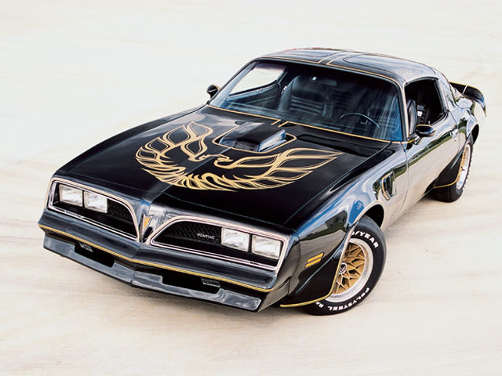
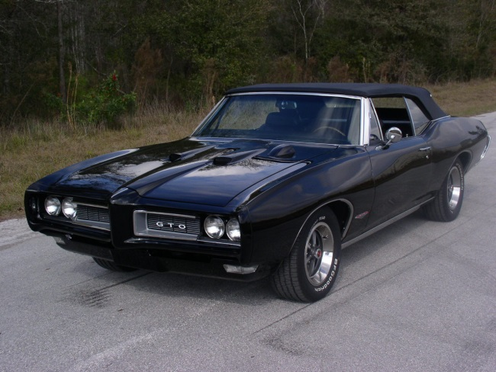
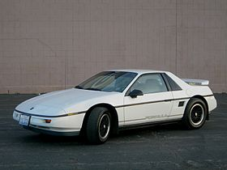
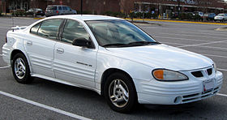
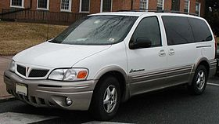
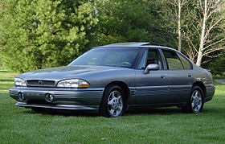
Don’t try to be all things to all people
But Pontiac wanted a bigger audience…
Where is Pontiac today?

Slide 36
Find a problem and solve it

Slide 37
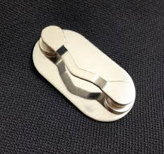
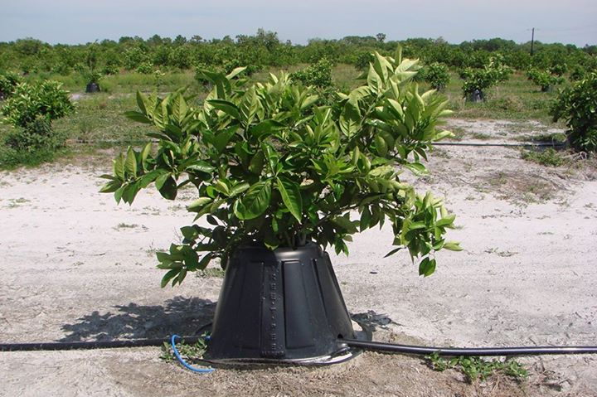
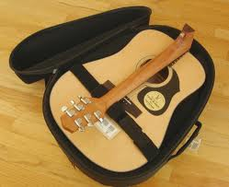
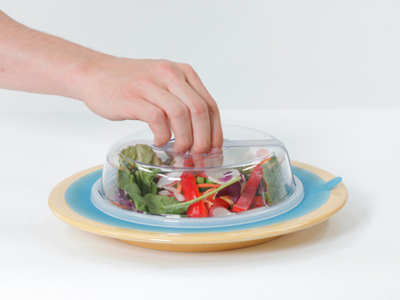
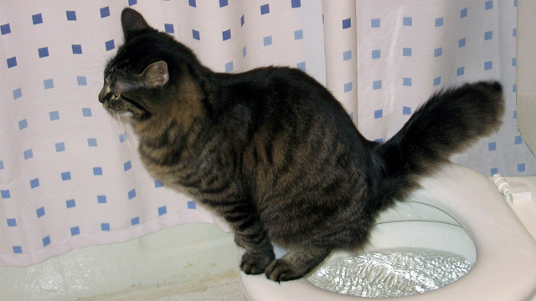
Find a problem and solve it

Slide 38
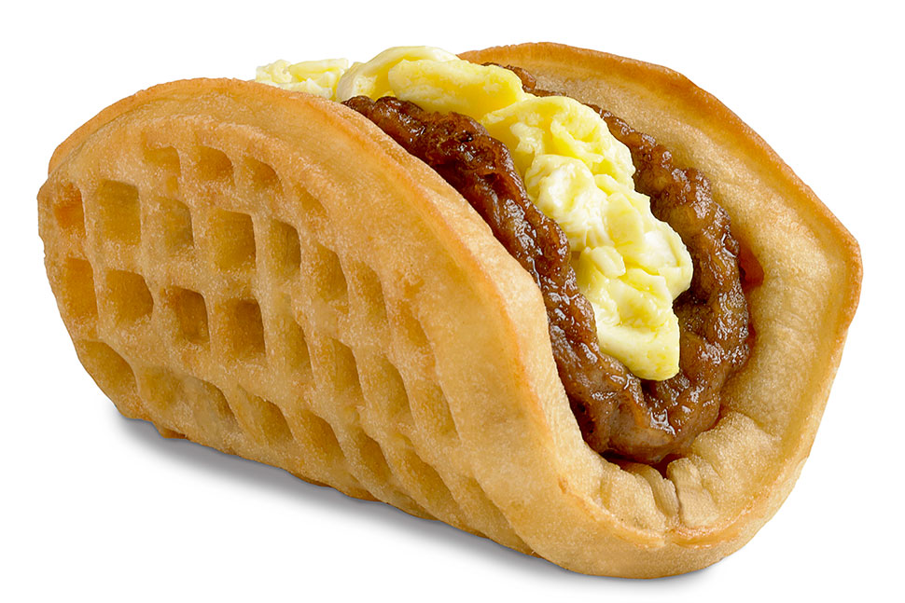
Find a void and fill it

Slide 39
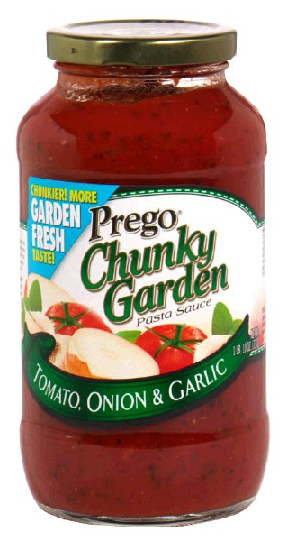
Find a want and deliver it
vs
What do people want?
1/3 Regular
1/3 Spicy
1/3 Chunky

Slide 40
Give visitors what they want
RIGHT
Get it
Content
Audience
Time

Slide 41
Download this presentation at: ppmkg.com/StoneyDslides

