Slide 2
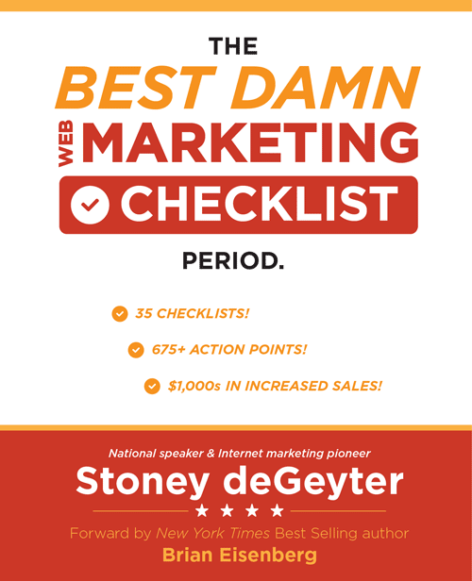
This is me
I do this
Web Presence Optimization
Follow me here
@StoneyD
linkedin.com/in/stoneygd
Stoney deGeyter
Read my book
WebMarketingChecklist.com
Hire my team
PolePositionMarketing.com

Slide 3
There are three levels of existence
Surviving
Thriving
Winning
Cons:
Loneliness
Poor health
Pros:
Minimal effort
Unlimited Netflix
Cons:
Takes effort
Will face obstacles
Pros:
Descent health
Balanced life
Cons:
Maximum effort
Involves severe pain
Pros:
Excellent health
Victory!

Slide 4
In business everything is a competition
Losing
Winning
Vs.

Slide 5
+ UX =
Website Architecture
Create Solid Architecture to Allows Engines and Your Audience to Find the Content They Want

Slide 6
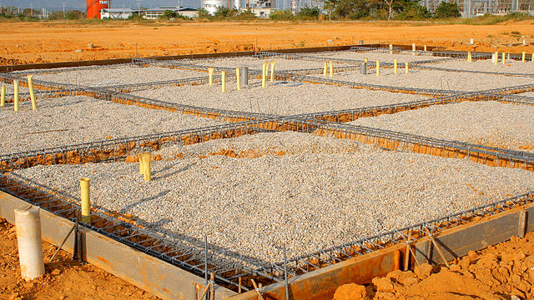
Site architecture is your foundation
When the foundation suffers, the whole site suffers.

Slide 7
Common problems with site architecture
Critical
Important
Other
Missing title tags
Missing meta descriptions
Duplicate content
Missing H1 tags
Slow loading pages
Poor mobile experience
Robot.txt issues
Crawl errors
Broken links
Missing alt tags
Sitemap issues
Pagination
Canonical tags
Cross-device page rendering
Structured data
Internal links
Too long/short title tags
Too long/short meta descriptions
Missing Hx tags
Pages not redirecting

Slide 8
Tools to access architecture issues
Xenu Link Sleuth
Google Search Console
Screaming Frog
Web Developer Toolbar
Moz Analytics
Bing Webmaster Tools
Wayback Machine
Google Analytics
Microsoft IIS

Slide 9
Navigation + UX =
Build Powerful Website Navigation that Keeps Visitors from Returning to Search Results

Slide 10
Customer focused navigation

Slide 11
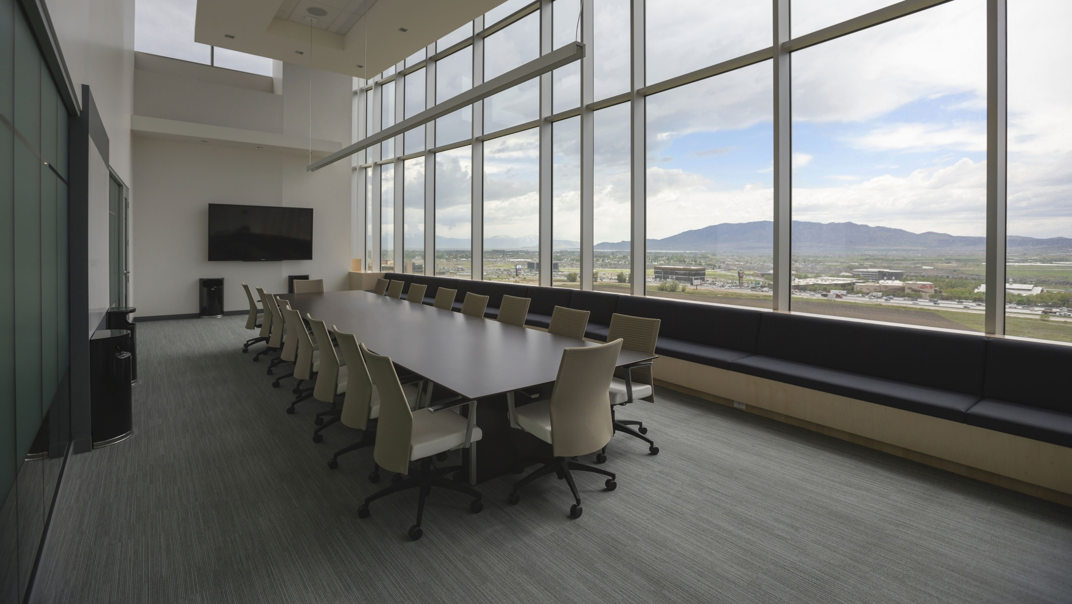
Company focused navigation

Slide 12
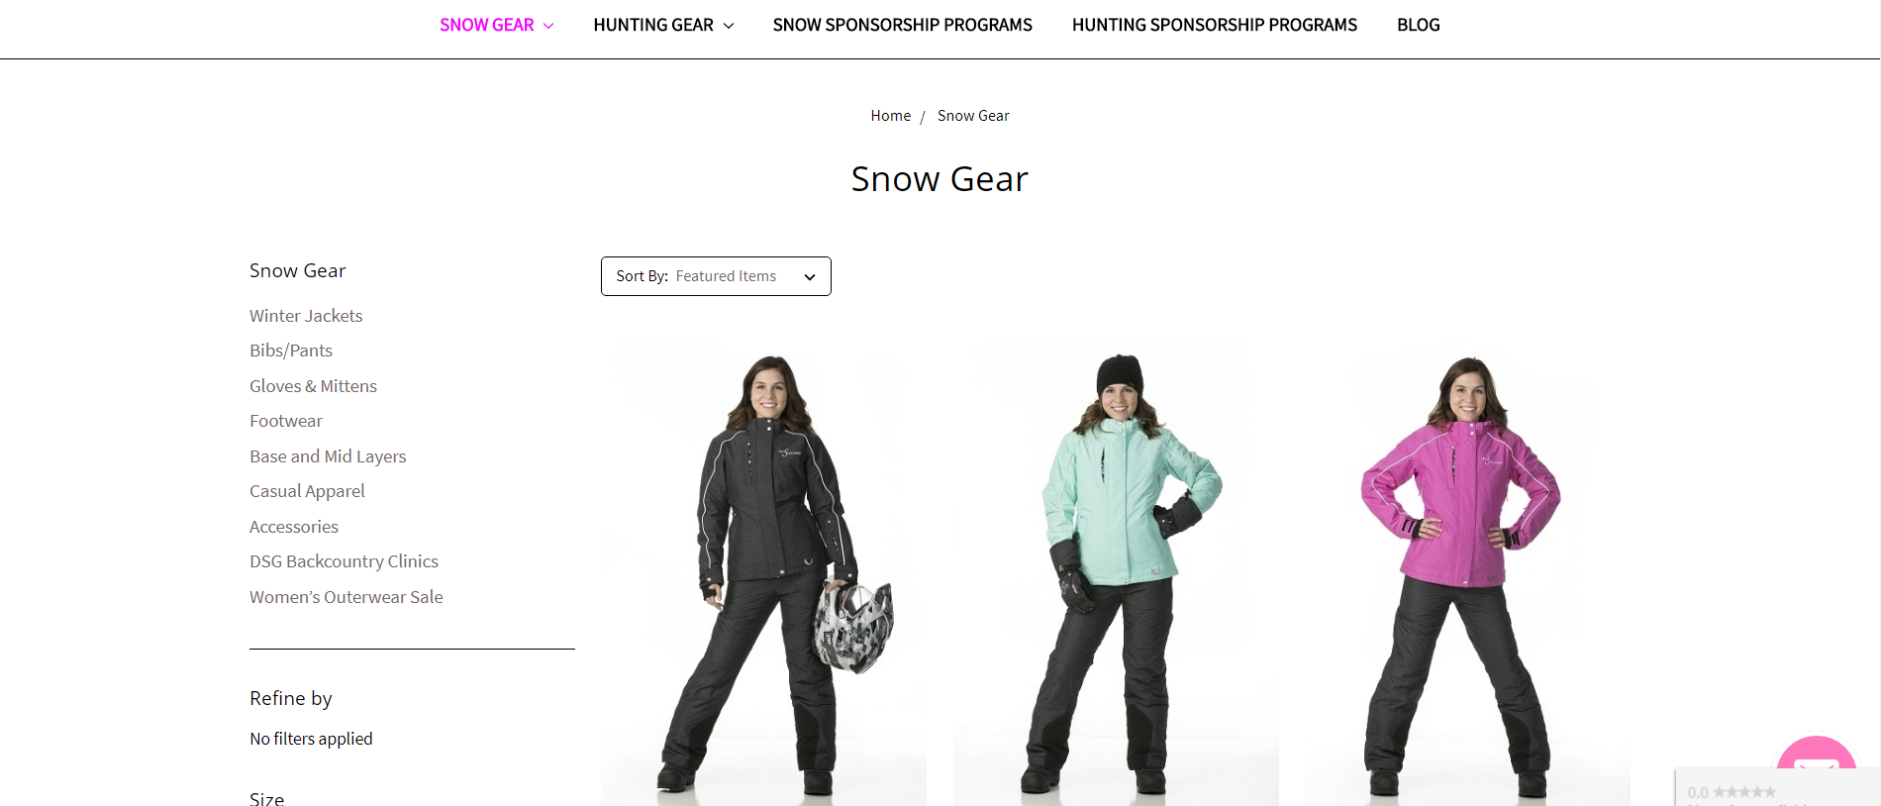
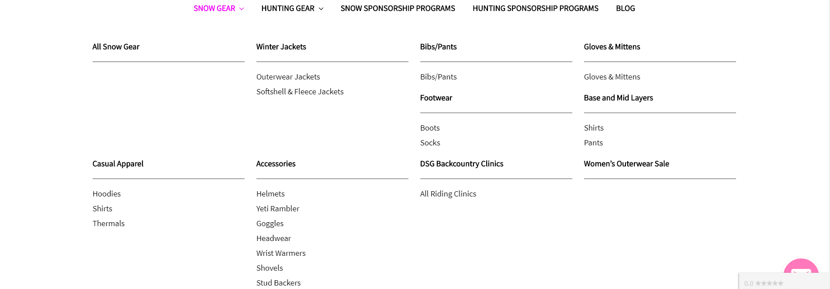
Click focused navigation

Slide 13
Keywords + UX =
Discover Keywords that Drive Traffic and Align Your Content with Searcher Intent

Slide 14
Old vs. new keyword research
To find phrases to insert into content.
To better understand searcher interest in a topic.
To better understand searcher intent for any given phrase.

Slide 15
Old vs. new keyword optimization
To make sure targeted phrases are represented in your content.
To write content that represents searcher interest in a topic.
Write content that outlines solutions searchers need.

Slide 16
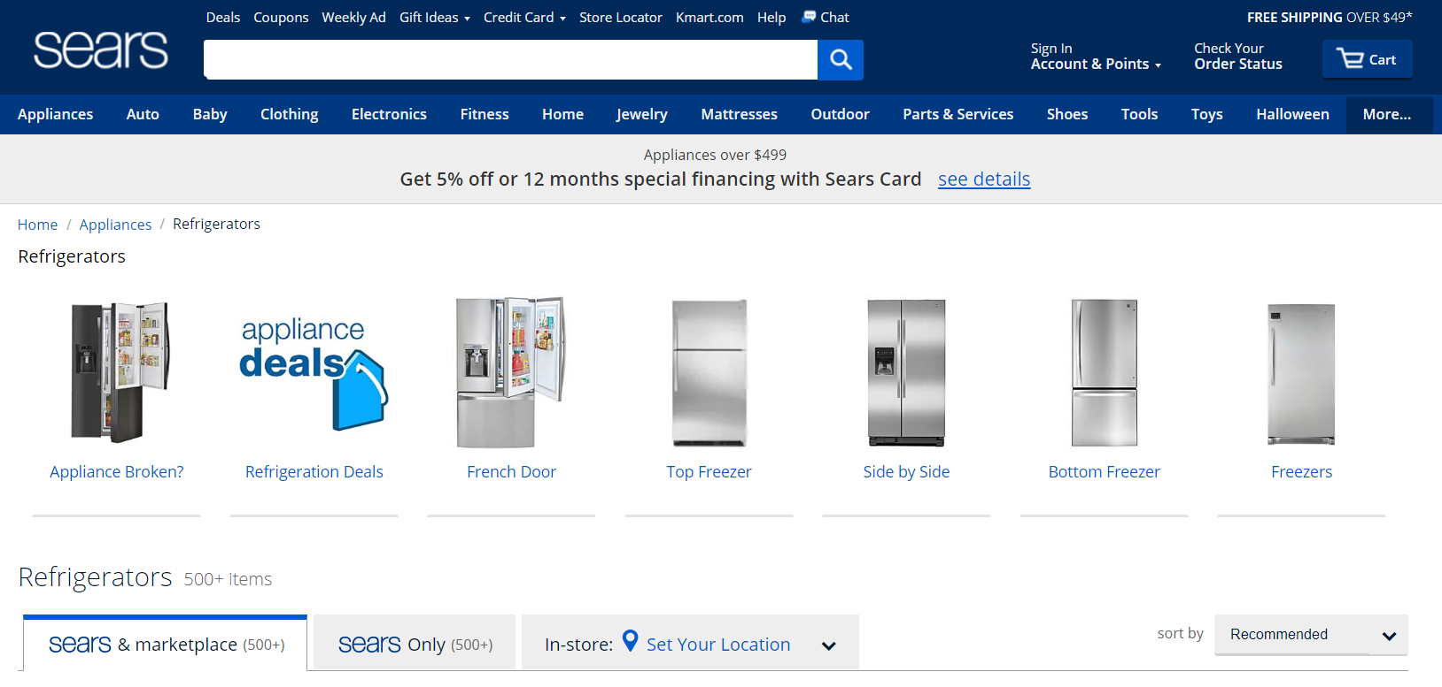
Shopping research intent keywords
Keywords
Content / Landing Page
A product category page that provides basic information on the products and allows you to begin your product research.
refrigerators
refrigerator
appliances refrigerators
appliances refrigerator
affordable refrigerators
affordable refrigerator
refrigerator new
refrigerators new
@StoneyD | #pubcon

Slide 17
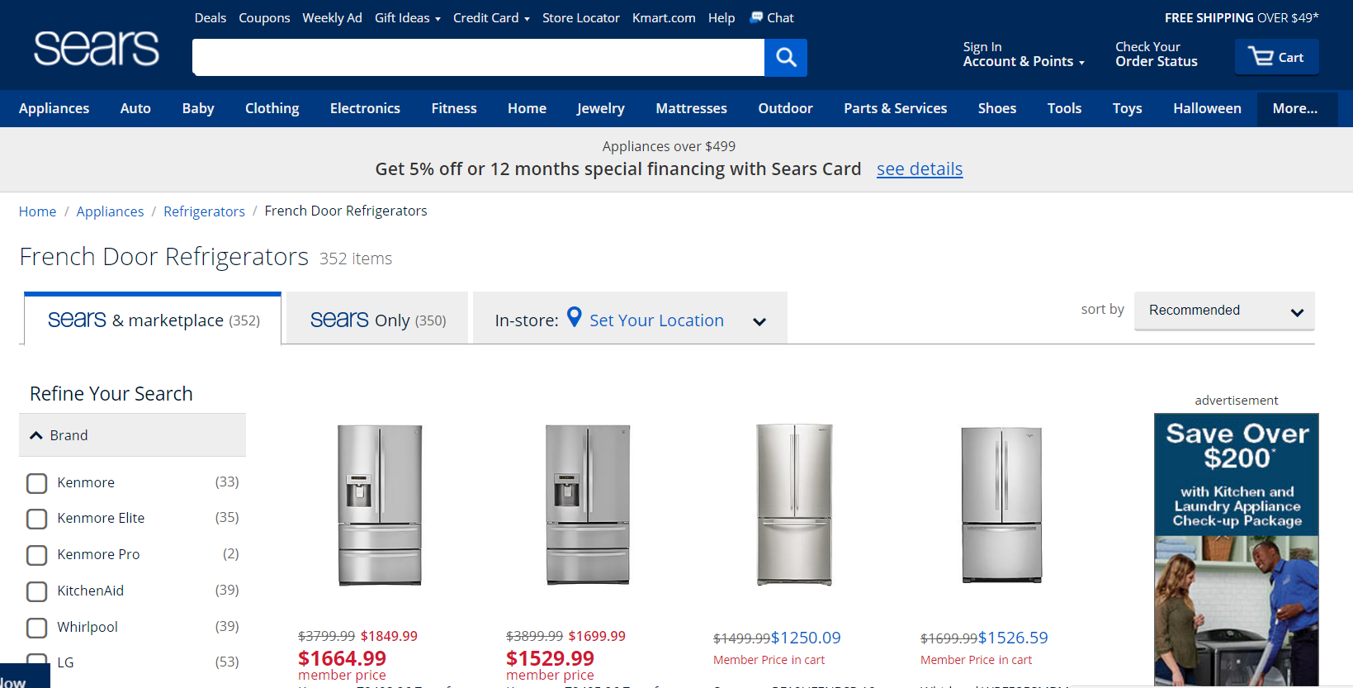
Shopping knowledge intent keywords
Keywords
Content / Landing Page
Content that provides searchers knowledge of the product and helps them dig deeper into additional options.
french door refrigerator
french door refrigerators
french style refrigerator
french style refrigerators
double door refrigerator
double door refrigerators
3 door refrigerator
3 door refrigerator
three door refrigerator
three door refrigerators
@StoneyD | #pubcon

Slide 18
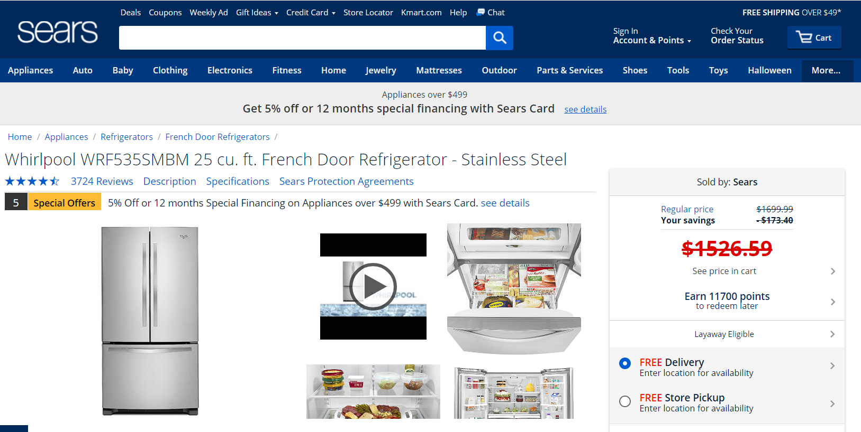
Shopping conversion intent keywords
Keywords
Content / Landing Page
Specific product description, specifications and details. Includes purchase security features and checkout options.
stainless steel french door refrigerator
stainless steel french door refrigerators
french door stainless steel refrigerator
french door stainless steel refrigerators
“” with ice maker
“” with black cabinet
“” 33 inch
“” white
@StoneyD | #pubcon

Slide 19
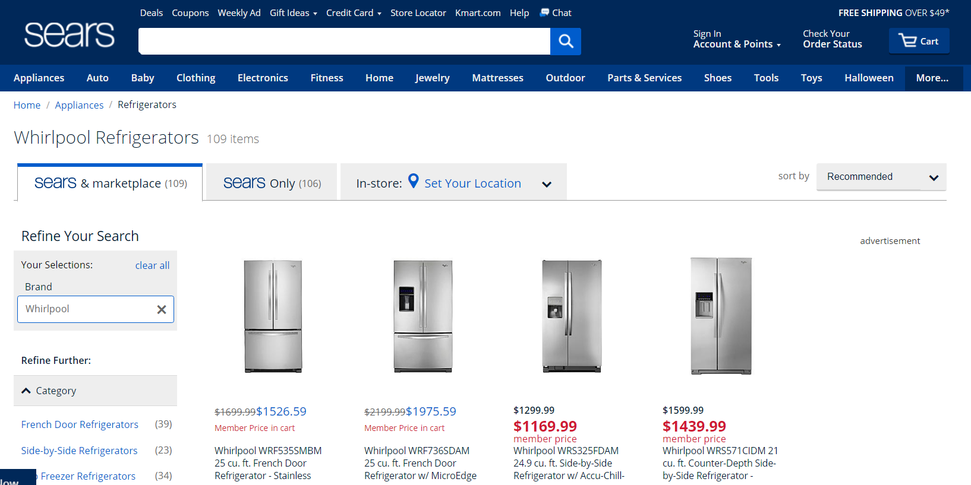
Brand knowledge intent keywords
Keywords
Content / Landing Page
Brand relevant content on page that displays brand relevant products and/or information.
whirlpool refrigerator
whirlpool refrigerators
stainless steel whirlpool refrigerator
stainless steel whirlpool refrigerators
whirlpool french door refrigerator
whirlpool french door refrigerators
@StoneyD | #pubcon

Slide 20
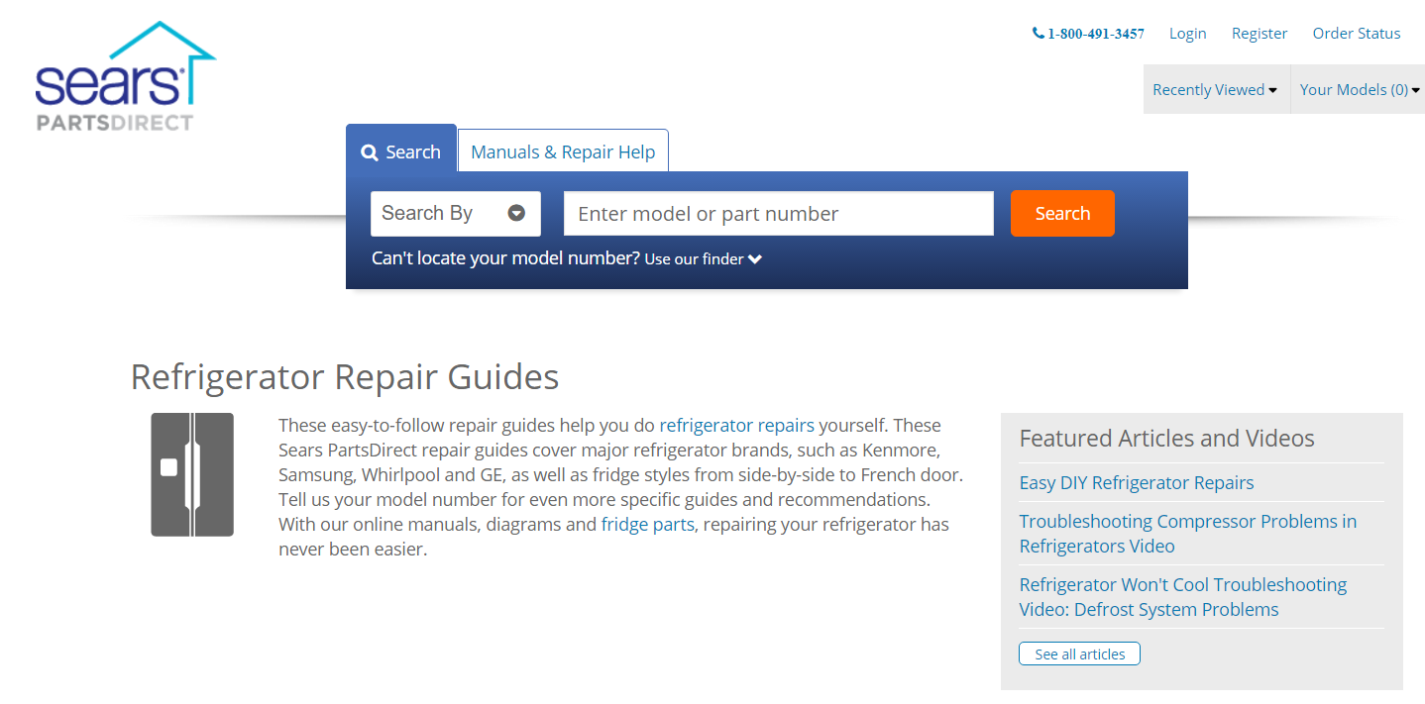
Information knowledge intent keywords
Keywords
Content / Landing Page
Blog post or library content that answers customer questions, solves problems or provides general how-to solutions.
how to fix a refrigerator
how to install a refrigerator
how to level a refrigerator on a sloped floor
ice machine not working
refrigerator replacement parts
how to replace refrigerator filter
@StoneyD | #pubcon

Slide 21
Write for your audience, not search engines
Pre-Owned Car
Used Car
You Sell
Customer Wants
Multi-directional Impact Insertion Device
Hammer
Porcelain Waste Disposal Receptacle
Toilet
Multi-Dimentional Travel Device
Time Machine

Slide 22
13 other uses for keyword research
1. Topical niche domination
2. Answering burning questions
3. Making existing content more robust
4. Learning your customers’ “language”
5. Improving your website’s navigation
6. New product or service research
7. Finding high-volume opportunities
8. Finding non-competitive, long-tail opportunities
9. Increasing click-throughs from SERPs
10. Understanding the searchers’ needs
11. Delivering searchers to the most relevant pages
12. Assessing your competition
13. Establishing expectations of success

Slide 23
Content + UX =
Write Engaging Content that Satisfies Searcher’s Interests and Compels Them To Click Deeper

Slide 24
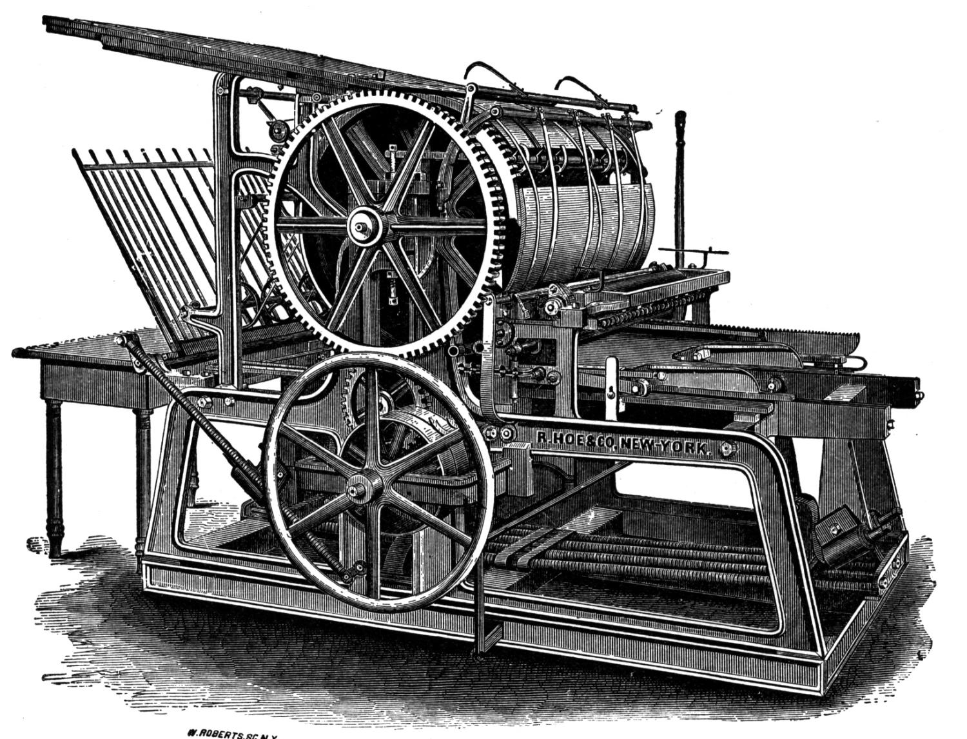
Every business is now in the publishing business
Consumers want more than a list of products to buy.
They want information that helps them buy the right products for their needs.

Slide 25
Build content that connects
Customers Want…
Tips
Tutorials
Advice
Help
Instructions
Demonstrations
Comparisons
…and they are more likely to buy from the brands that provide it.
Produce the content your customers want on a regular basis.

Slide 26
Great content creates exposure opportunities

Slide 27
Great content creates exposure opportunities

Slide 28
Great content creates exposure opportunities
Every piece of content is a potential entrance to your website.

Slide 29
+ UX =
Social Media
Engage with Social Media to Achieve Exposure to Your Products and Services

Slide 30
Content without promotion is

Slide 31
Social media is about engagement
Create social profiles that will be followed.
Expand content reach into places it otherwise wouldn’t get noticed.
Increase engagement with your brand.
The role of the social media

Slide 32
Socialize to give, not receive
20
%
Sharing and promoting content that is yours.
Sharing and promoting content that is not yours.
80
%

Slide 33
Social improves factors search algorithms like
Social media increases:
Exposure
Searches
Clicks
Mentions
Links
Google likey!

Slide 34
Analytics + UX =
Use Analytics to Pinpoint and Fix Areas Where User Experience is Faltering

Slide 35
Site speed
Compressed Images
Minimized & Streamlined Code
Fast Servers

Slide 36
Click thru rates
Title Tags
URLs
Breadcrumbs
Meta Descriptions

Slide 37
High bounce pages
Matches Intent
Encourages Engagement
Presents Action
Fulfills Desire

Slide 38
High exit pages
What went wrong?

Slide 39
High traffic / low engagement
Assess
Prioritize
Fix

Slide 40
SEO = UX =
Use Effective Digital Marketing to Building the Best Possible Experience for Your Visitors

Slide 41
Search engines are just looking for winners

Slide 42
Getting visitors is pointless if they don’t stay

Slide 43
Make your site easy for your visitors
Easy to navigate
Clear calls to action
Simplified contact options
Minimum shopping hindrances
Key Point: Don’t make them think!

Slide 44
Test to perfection
Image placements
Button colors
Link locations
Layouts
Forms
Navigation paths

Slide 45
Download this presentation at: ppmkg.com/StoneyDslides

